Slide 1
Implementing CUDA Code for Fast Fourier Transform

Slide 2
FFT Introduction

Slide 3

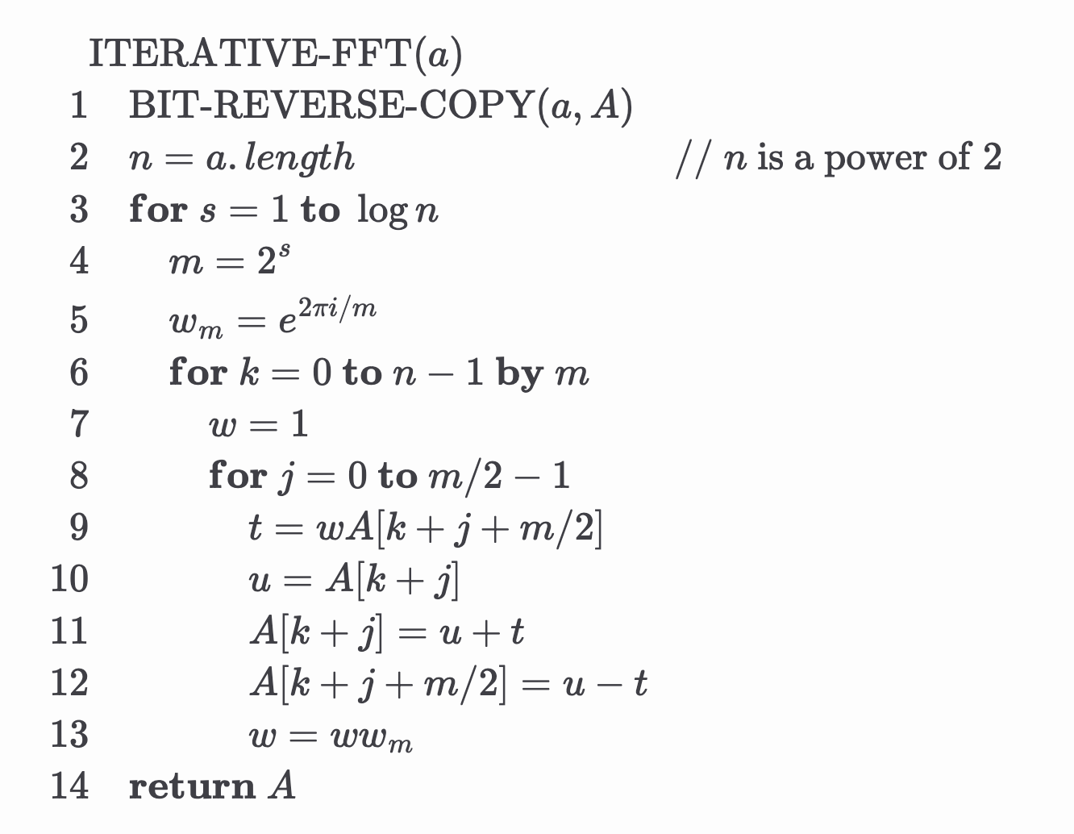
Pseudo-Code for FFT
BIT-REVERSE-COPY(a, A):
Rearranges the input array so that elements are indexed by the reversed binary representation of their original index. This prepares the data for the FFT’s butterfly calculations.
For Loops:
Executes a series of layered butterfly computations, progressively merging results until it produces the final frequency-domain transformation in O(n log n) time.

Slide 4
FFT operations
Input and output for performing an FFT on a single row:
Consider the input as a sequence of pixel intensity values from a single row of an image. Suppose the length of this row is N, and it consists of elements {x₀, x₁, x₂, ..., x_{N-1}}. We can think of this as a one-dimensional discrete signal.
After performing a 1D FFT on this row, we obtain a sequence of complex values {X₀, X₁, X₂, ..., X_{N-1}}. Each Xₖ corresponds to a specific “spatial frequency” component present in that row.
What the FFT results represent:
In images, “frequency” does not correspond to changes over time (as it does in audio signals), but rather to how rapidly the intensity changes across space.
Low-frequency components (near X₀): These represent the slowly varying intensity trends within the row. For example, a gradual increase or decrease in brightness from left to right, reflecting broad, smooth background variations.
High-frequency components (towards the end of the sequence, near X_{N-1}): These represent rapid changes in intensity. In other words, they capture details such as sharp edges, abrupt transitions in brightness, and fine textural patterns.

Slide 5
CUDA Implementation

Slide 6
FFT Process(Sequential)
Greyscaling
Initialization of FFT Input
Processing the FFT Along Rows
Processing the FFT Along Columns
Centering the Frequency
Calculate Maximum Magnitude and Normalize

Slide 7

Greyscaling
The input image, potentially in RGB format, is converted into a single-channel grayscale image.
This is done by taking a weighted average of the red, green, and blue channels:
$$Gray=0.299×R+0.587×G+0.114$$
The FFT operates on a single-valued function. Working with grayscale simplifies the problem by removing color complexity, leaving a single intensity value per pixel.

Slide 8
Initialization of FFT Input
If the original dimensions are not powers of two, the matrix is zero-padded.
Copy the grayscale image data into a 2D complex matrix data of size h by w. Each pixel’s intensity is placed in the complex matrix with a real component equal to the pixel value and an imaginary component of zero.

Slide 9
Processing the FFT Along Rows
Perform a 1D FFT on each row of the matrix.
The 1D FFT is done iteratively:
Bit-reversal ordering: Reorders the data so that the subsequent butterfly operations can proceed in-place efficiently.
Butterfly operations: In multiple stages, pairs of elements (butterflies) are combined using complex arithmetic and twiddle factors, progressively transforming the time-domain row data into frequency-domain data.

Slide 10
Processing the FFT Along Columns
Perform the same operation on columns

Slide 11
Centering the Frequency
The zero frequency appears at the center of the image.
This makes the spectrum more intuitive to analyze visually, placing low frequencies in the center and high frequencies toward the edges.

Slide 12

Calculate Maximum Magnitude and Normalize
Compute the magnitude of each complex frequency component:
$$\left|F\left(u, v\right)\right|=\sqrt{{Re(F(u, v))}^{2}+{Im(F(u, v))}^{2}}$$
Apply a log transform to the magnitudes:
$$\log\left(1+\left|F\left(u, v\right)\right|\right)$$
This reduces the dynamic range, making subtle frequencies more visible.
Find the maximum log-magnitude to normalize all values into a [0, 255] range.
Store these normalized values into the output image.

Slide 13
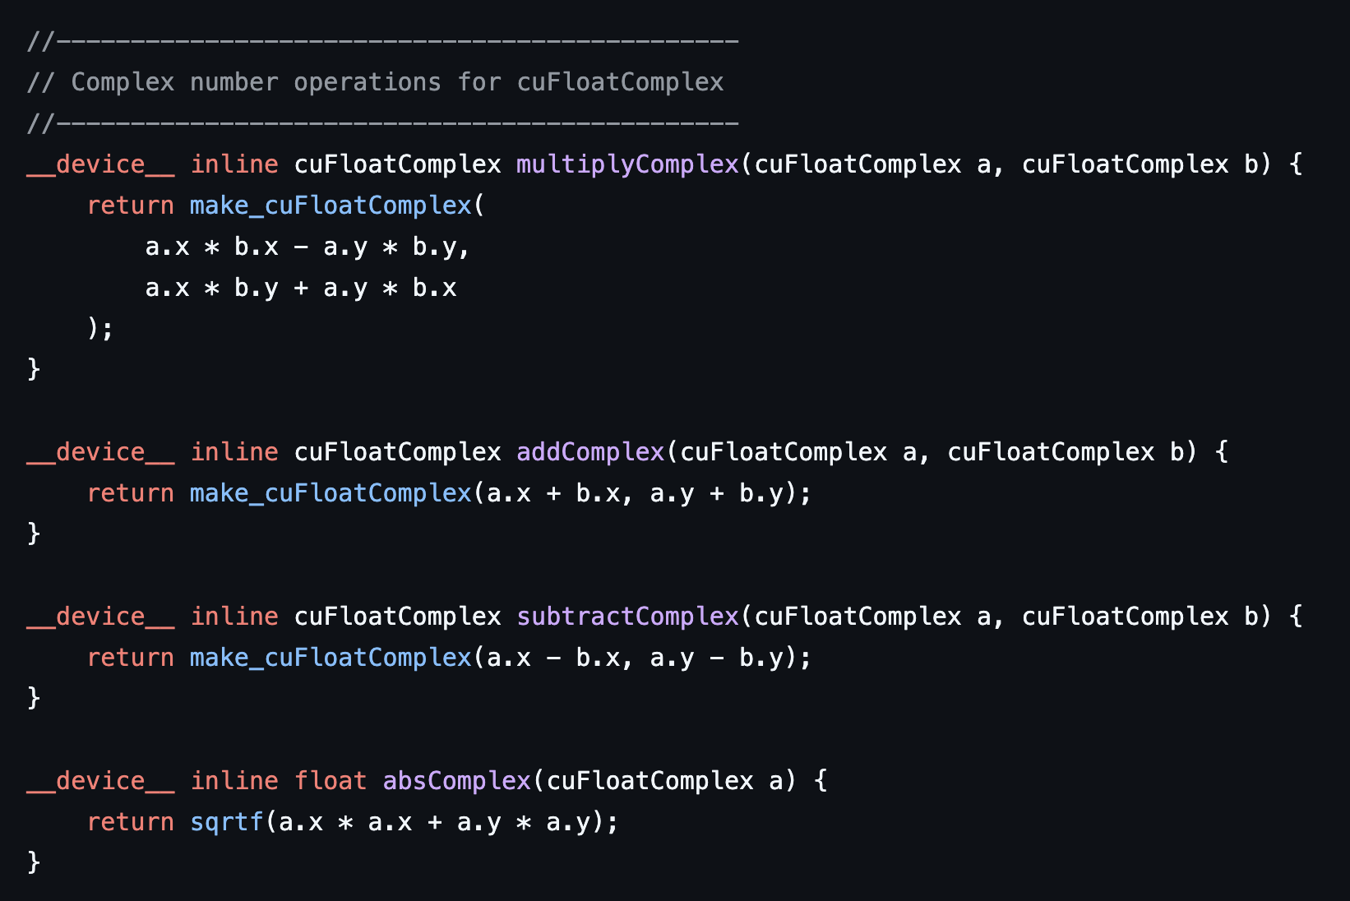
Calculate Complex numbers in cuda
cuFloatComplex is a CUDA type representing a complex number with single-precision floating-point components. It stores the real part in x and the imaginary part in y.

Slide 14
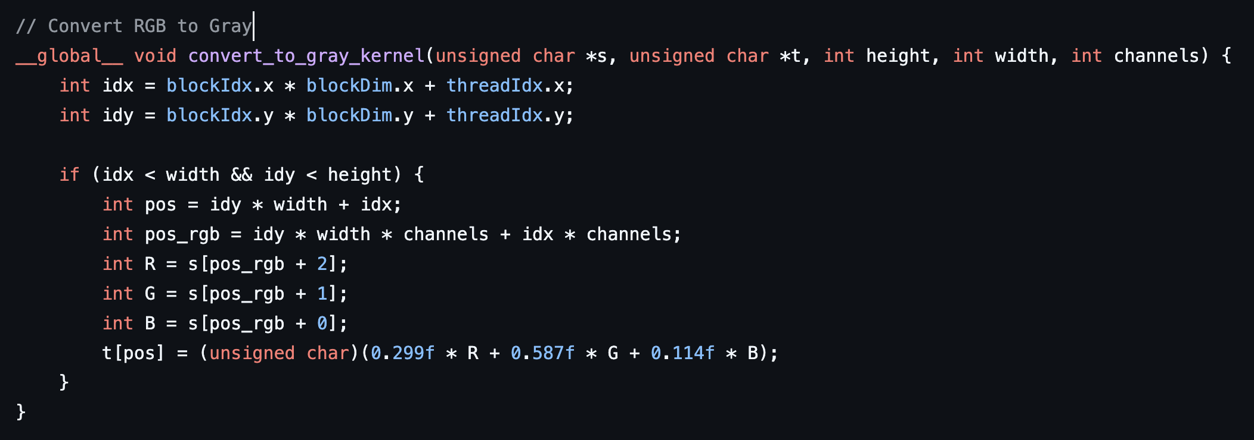
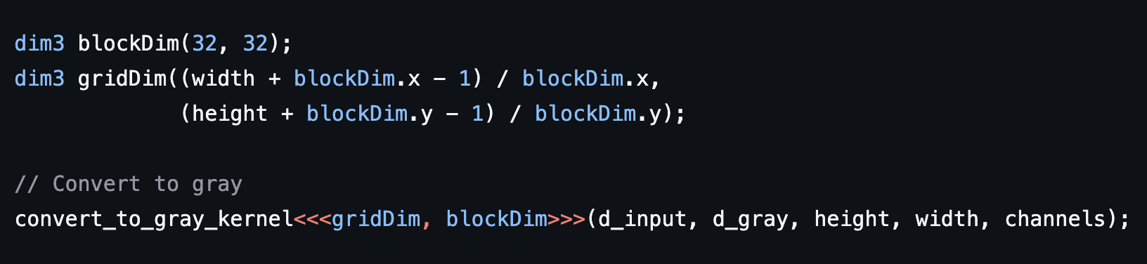
Greyscale kernel
A total of 32 x 32 = 1024 threads are launched. We want to utilize maximum threads within a block.
Coalesced memory accesses

Slide 15
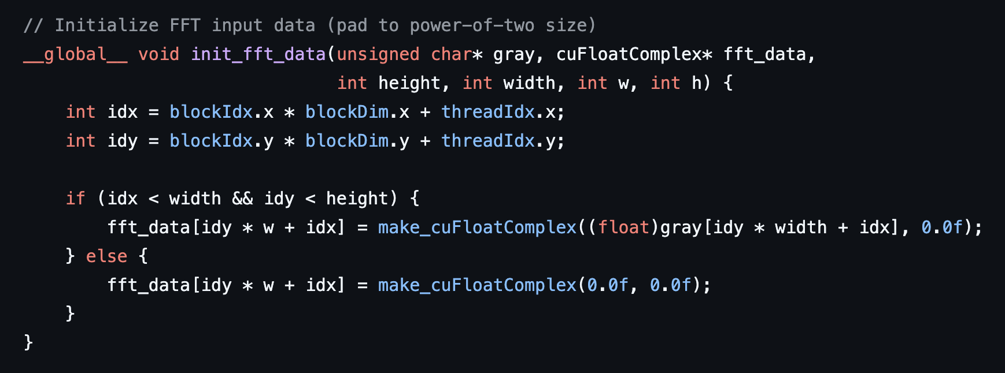
init_fft_data
Write the grayscaled pixels into complex numbers and zero-pad the array to dimensions that are powers of 2.
Coalesced memory access for row-wise operations

Slide 16
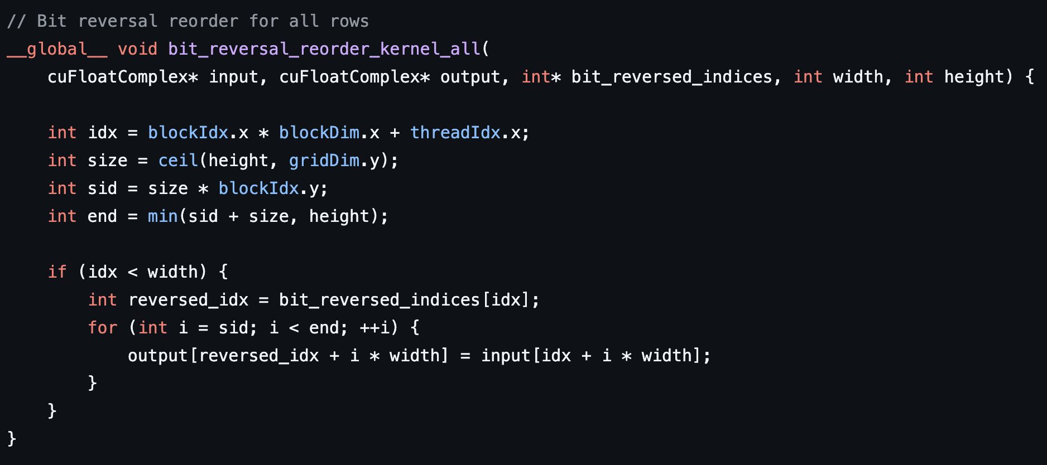
bit_reversal_reorder_kernel_all
Performs bit-reversal indexing for the FFT reordering step on all rows with one kernel launch.
Reading from input[idx + i * width] is coalesced since idx moves linearly across a row.
Writing to the FFT output array is not coalesced, since bit_reversed_indices[idx] might store uncontiguous data

Slide 17
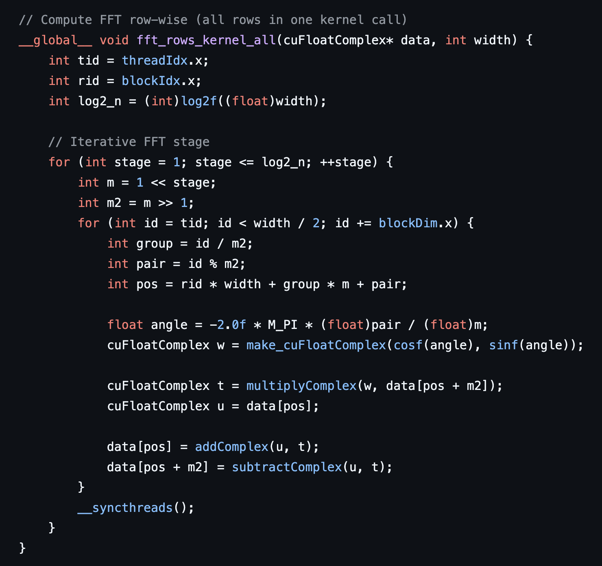
Fft_rows_kernel_all(For large images)
Performs FFT row-wise.
Reads/writes data directly from global memory.(Not enough shared memory if the row contains a large amount of data)

Slide 18
Fft_rows_kernel_shared(For small images)
Same operation as fft_rows_kernel_all() but with shared memory
The use of shared memory greatly improves performance.
The kernel loads an entire row (or a chunk of it) into shared memory in a coalesced manner

Slide 19
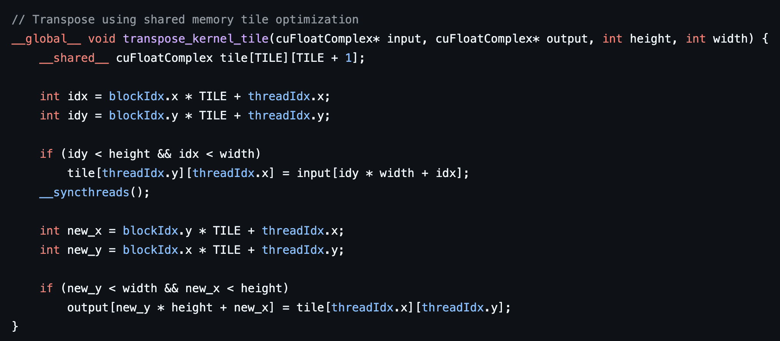
Transpose_kernel_tile
Transposes the matrix so now columns are in row-major order to ensure coalesced access.

Slide 20
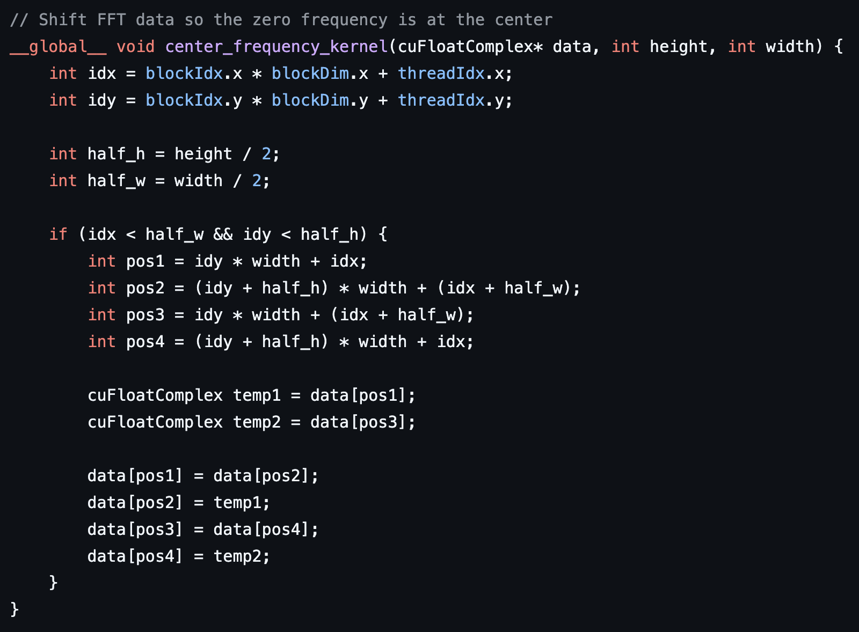
center_frequency_kernel
Re-centers the frequency components by swapping quadrants.
Reads and writes are performed in a manner that tries to load contiguous chunks for each warp. The data swapping involves reading from four symmetrical positions.

Slide 21
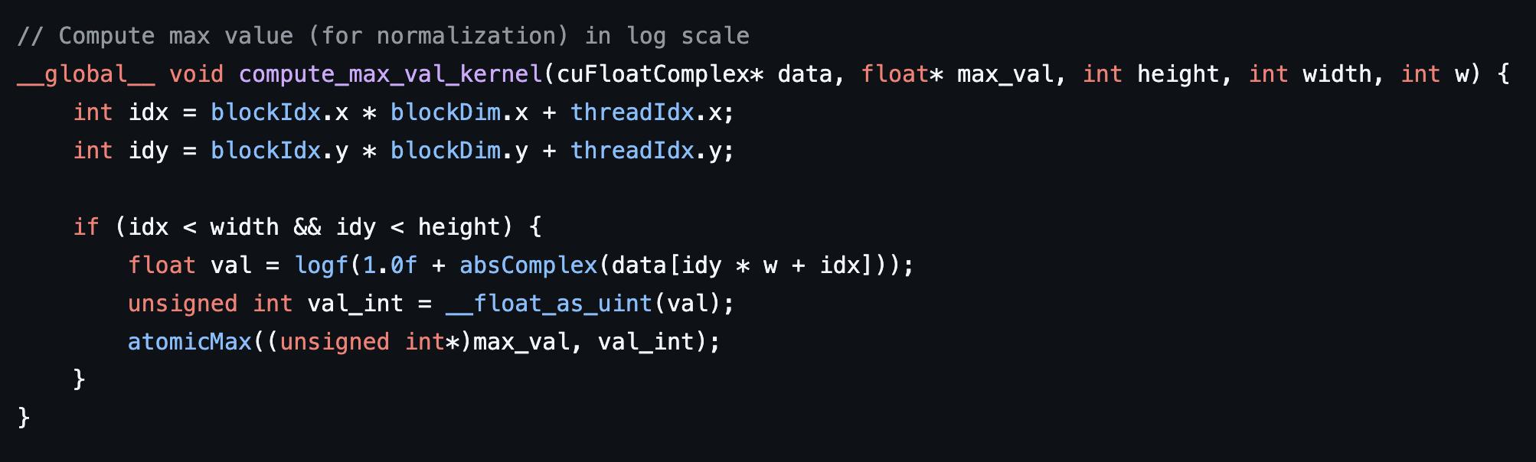
compute_max_val_kernel
Finds the maximum magnitude (in log scale) to normalize the output.
By using atomicMax, each thread’s attempt to update the global maximum is executed atomically.

Slide 22
Result and analysis

Slide 23


Performing fft on an image

Slide 24
reference
FFT Image: https://ww2.mathworks.cn/discovery/fft.html
Nvidia Cuda Logo: https://en.wikipedia.org/wiki/CUDA#/media/File:Nvidia_CUDA_Logo.jpg

